Slide 1
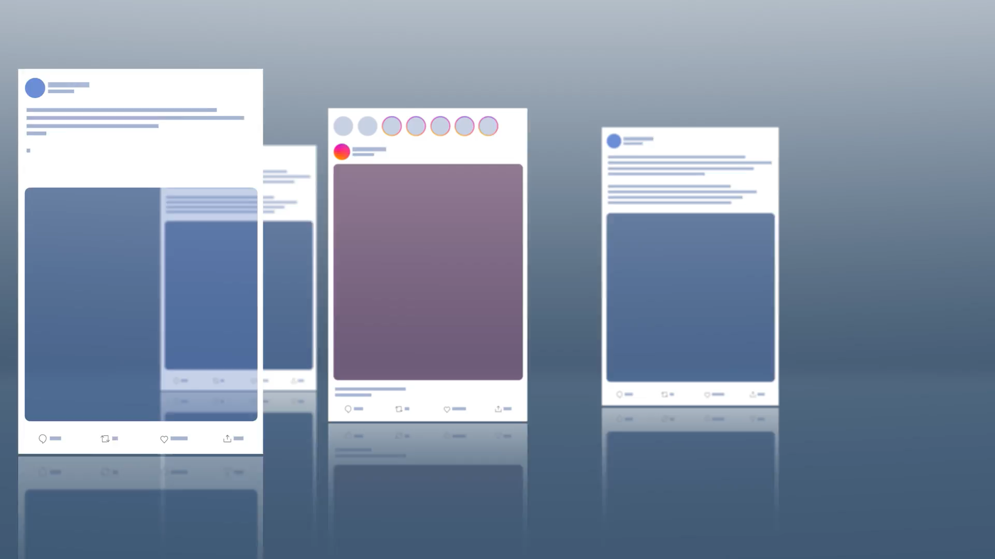

Slide 2

31-1-2025, Complex System Simulations, group 4

Slide 3
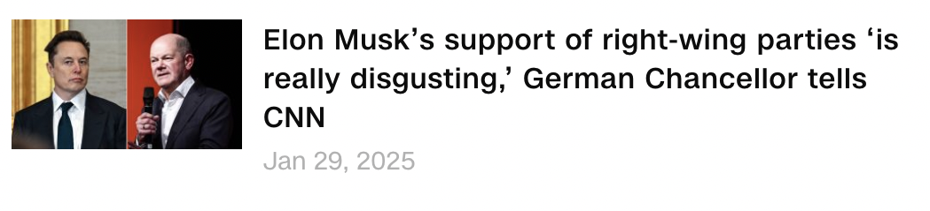
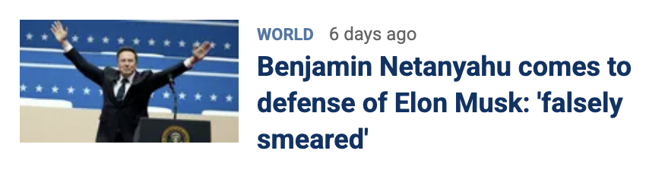
Polarization at all time high in 50 years
31-1-2025, Complex System Simulations, group 4

Slide 4
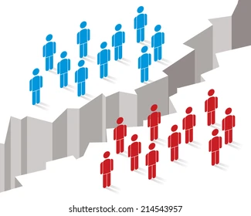

A division that forms between groups caused by opposing politcal views
31-1-2025, Complex System Simulations, group 4

Slide 5
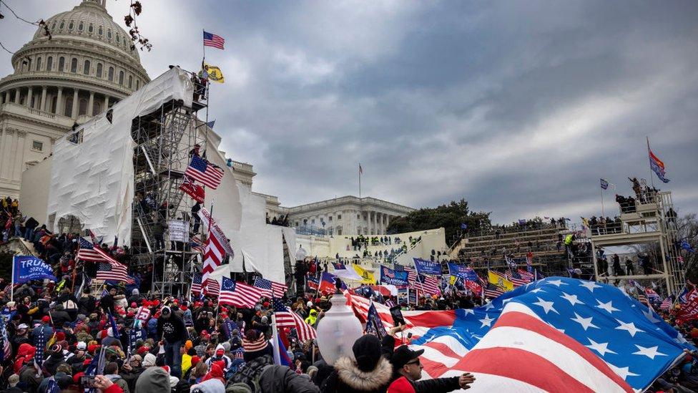
Why polarisation is dangerous
Social cohesion breakdown
Gridlock in governance
Violence
31-1-2025, Complex System Simulations, group 4

Slide 6

PARADOX: polarization even though people don’t share their political views
31-1-2025, Complex System Simulations, group 4

Slide 7
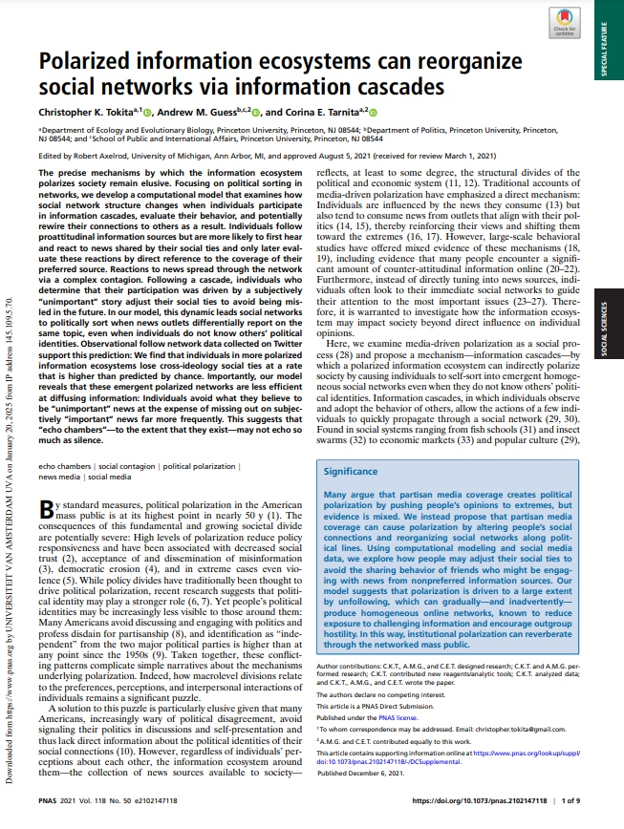
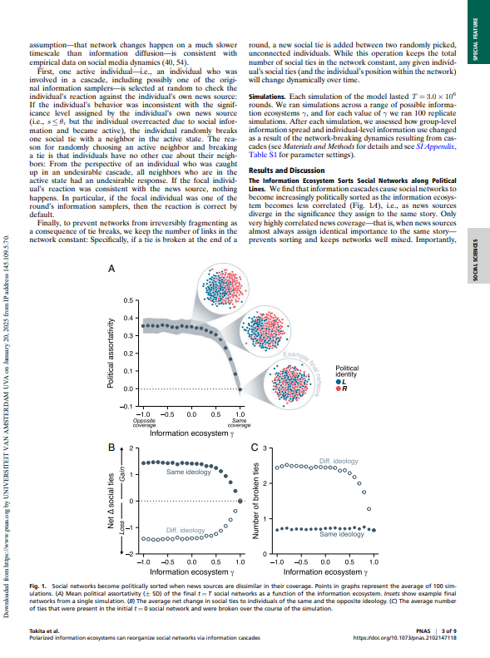
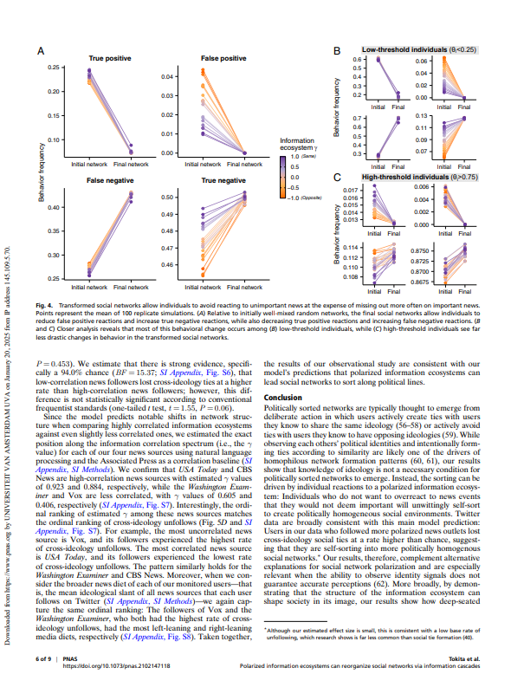
Tokita, C. K., Guess, A. M., & Tarnita, C. E. (2021). Polarized information ecosystems can reorganize social networks via information cascades. Proceedings of the National Academy of Sciences, 118(50), e2102147118.
31-1-2025, Complex System Simulations, group 4

Slide 8
Intuition behind algorithm
Unfollowing those people who share news stories you find unimportant
31-1-2025, Complex System Simulations, group 4

Slide 9


The algorithm
31-1-2025, Complex System Simulations, group 4
Media
Population

Slide 10

Population
Media
31-1-2025, Complex System Simulations, group 4

Slide 11
Media
L
Left news sources
31-1-2025, Complex System Simulations, group 4
R
Unimportant
Important
S
0
S is low, implying low imortance
1
Right news sources

Slide 12
Media
New variable: S
Denotes how significant a news article is
L
R
Left news sources
Right news sources
31-1-2025, Complex System Simulations, group 4

Slide 13
Media
S
New variable:
Denotes how significant a news article is
L
R
Unimportant
S
Important
Left news sources
Right news sources
0
1
31-1-2025, Complex System Simulations, group 4

Slide 14
Media
γ
Second variable:
Denotes how left and right news is correlated
L
R
Unimportant
Important
S
0
1
31-1-2025, Complex System Simulations, group 4

Slide 15
Uncorrelated
correlated
Media
γ
-1
1
γ
Second variable:
Denotes how left and right news is correlated
L
R
Unimportant
Important
S
0
1
31-1-2025, Complex System Simulations, group 4

Slide 16
Complete opposite
correlated
γ
-1
1
Media
L
R
Unimportant
Important
S
0
1
31-1-2025, Complex System Simulations, group 4

Slide 17
Complete opposite
correlated
γ
-1
1
Media
L
R
Unimportant
Important
S
0
1
31-1-2025, Complex System Simulations, group 4

Slide 18
Complete opposite
correlated
γ
-1
1
Media
L
R
Unimportant
Important
S
0
1
31-1-2025, Complex System Simulations, group 4

Slide 19
Complete opposite
correlated
γ
-1
1
Media
L
R
Unimportant
Important
S
0
1
31-1-2025, Complex System Simulations, group 4

Slide 20
Complete opposite
correlated
Uncorrelated
γ
-1
0
1
Media
L
R
Unimportant
Important
S
0
1
31-1-2025, Complex System Simulations, group 4

Slide 21
Complete opposite
correlated
Uncorrelated
γ
-1
0
1
Media
R
L
Unimportant
Important
S
S
0
1
31-1-2025, Complex System Simulations, group 4

Slide 22
Complete opposite
correlated
Uncorrelated
γ
-1
0
1
Media
R
L
Unimportant
Important
S
S
0
1
31-1-2025, Complex System Simulations, group 4

Slide 23
Complete opposite
correlated
Uncorrelated
γ
-1
0
1
Media
R
L
Unimportant
Important
S
S
0
1
31-1-2025, Complex System Simulations, group 4

Slide 24
Complete opposite
correlated
Uncorrelated
γ
-1
0
1
Media
So how do we use ?
L
R
Unimportant
Important
S
S
0
1
31-1-2025, Complex System Simulations, group 4

Slide 25
Media
So how do we use ?
S
S
31-1-2025, Complex System Simulations, group 4

Slide 26
Media
Population
31-1-2025, Complex System Simulations, group 4
L
R

Slide 27
Population
L
31-1-2025, Complex System Simulations, group 4
R
Not activated
Activated
Cares about Right news sources only
Threshold θᵢ *
* θᵢ chosen random from Uniform distribution

Slide 28
Population
L
R
31-1-2025, Complex System Simulations, group 4
R
L
Unimportant
Important
S
0
1

Slide 29
Population
All nodes have a different
Threshold θᵢ ~ U[0, 1]
31-1-2025, Complex System Simulations, group 4

Slide 30
Population
All nodes have a different
Threshold θᵢ ~ U[0, 1]
A fraction become samplers.
31-1-2025, Complex System Simulations, group 4

Slide 31
Population
All nodes have a different
Threshold θᵢ ~ U[0, 1]
A fraction become samplers.
Those who think the news is important enough become Active
31-1-2025, Complex System Simulations, group 4

Slide 32
Population
All nodes have a different
Threshold θᵢ ~ U[0, 1]
A fraction become samplers.
Those who think the news is important enough become Active
31-1-2025, Complex System Simulations, group 4

Slide 33
For samplers:
Active if S > θᵢ
For the rest:
Active if fraction neighbors > θᵢ
θᵢ = 0.5 θᵢ = 0.5
31-1-2025, Complex System Simulations, group 4

Slide 34
For samplers:
Active if S > θᵢ
For the rest:
Active if fraction neighbors > θᵢ
This is a cascade
θᵢ = 0.5 θᵢ = 0.5
31-1-2025, Complex System Simulations, group 4

Slide 35
For samplers:
Active if S > θᵢ
For the rest:
Active if fraction neighbors > θᵢ
This is a cascade
θᵢ = 0.5 θᵢ = 0.5
A cascade is neighbors activating each other by sharing news
31-1-2025, Complex System Simulations, group 4

Slide 36
Restructuring Network
31-1-2025, Complex System Simulations, group 4

Slide 37
Restructuring Network
31-1-2025, Complex System Simulations, group 4

Slide 38
Restructuring Network
31-1-2025, Complex System Simulations, group 4

Slide 39
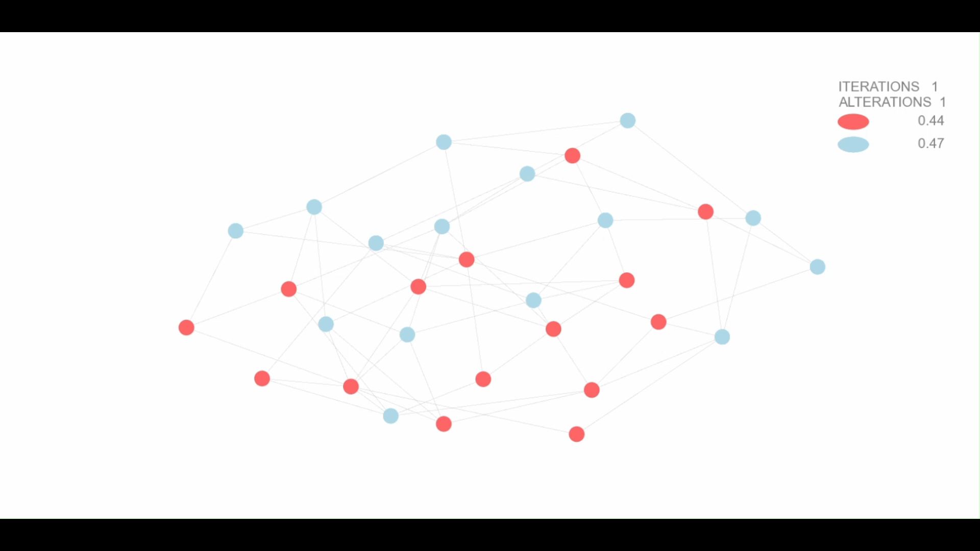
SAMPLERS
ACTIVE

Slide 40
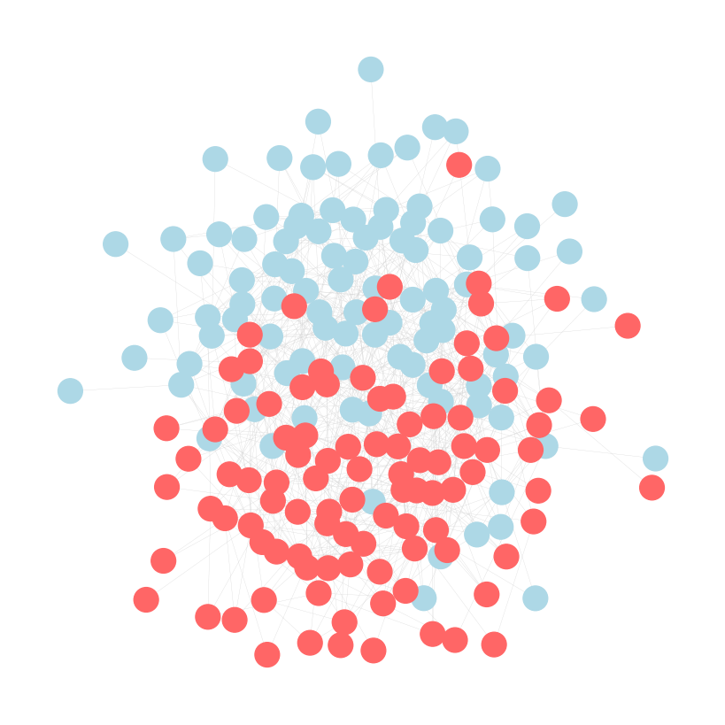
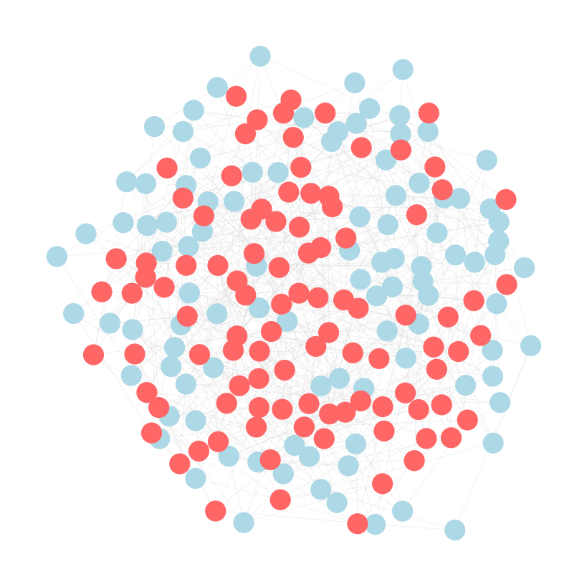
Iteration 0
Iteration 200.000
0.54
0.48
0.75
0.70

Slide 41
IMPORTANT: Breaking a connection is based on news spreading not on political background
31-1-2025, Complex System Simulations, group 4

Slide 42
Research question
How does news correlation influence the polarization of a network without individuals knowing each others political views?
Does this work for a scale-free network?
31-1-2025, Complex System Simulations, group 4

Slide 43
Hypothesis
Emergence of polarization occurs in both networks
Decreasing the correlation between news-sources, will result in a more polarized social network. Possibly with a certain correlation threshold resulting in a phase- transition
31-1-2025, Complex System Simulations, group 4

Slide 44
Metrics
Political Assortativity
Net Change in Social Ties
Lost and gained connections
Cascade Sizes
Cascade bias
31-1-2025, Complex System Simulations, group 4

Slide 45
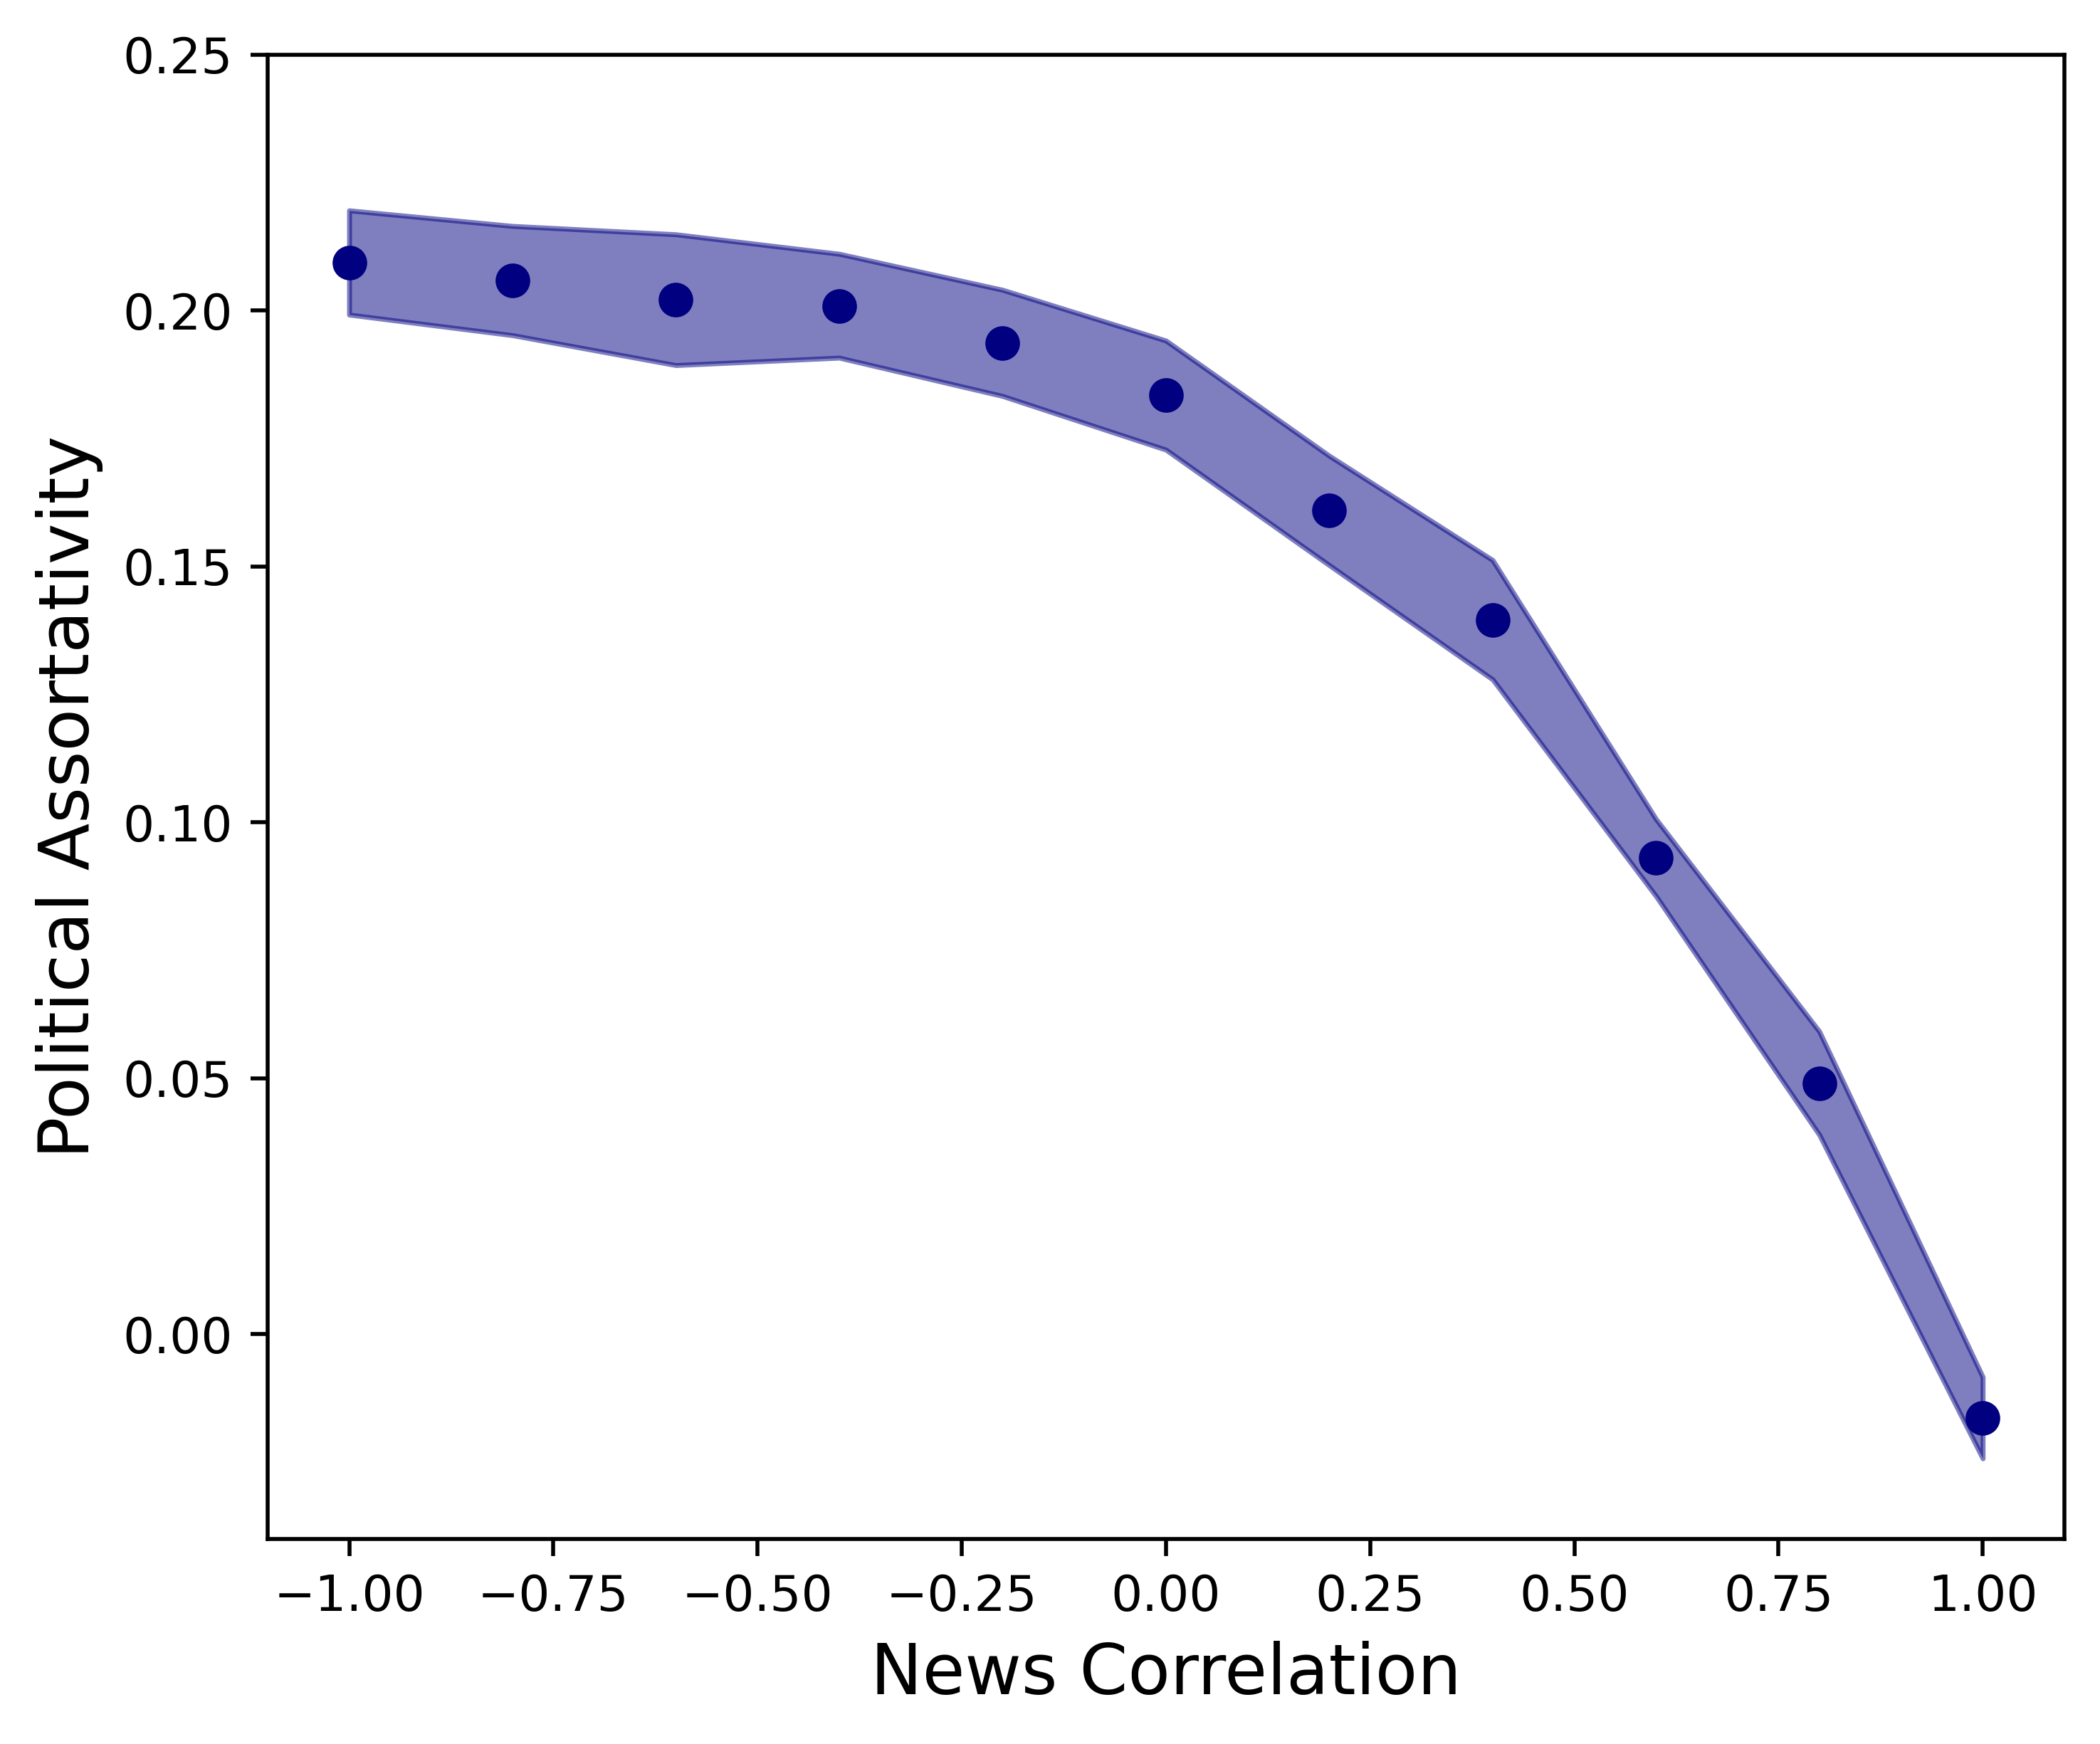
Political Assortativity of a Random Network
Highly correlated news
No assortativity
Less correlated news
Increasing assortativity
31-1-2025, Complex System Simulations, group 4

Slide 46
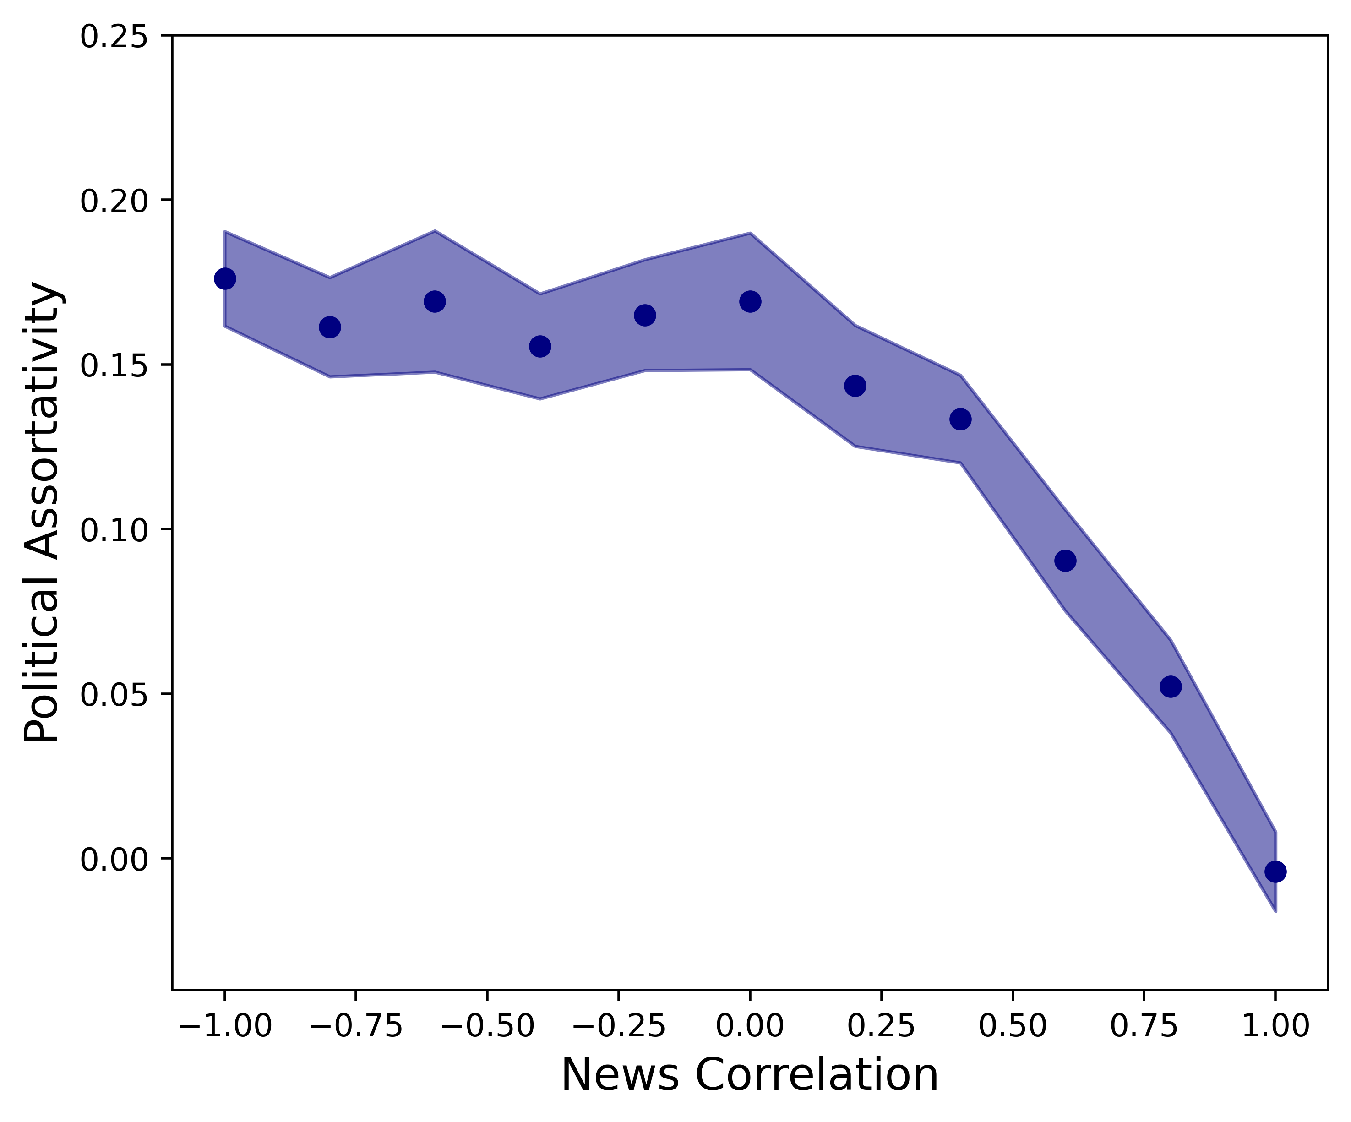
Random vs. Scale-free
Difference between random and scale-free?
31-1-2025, Complex System Simulations, group 4

Slide 47
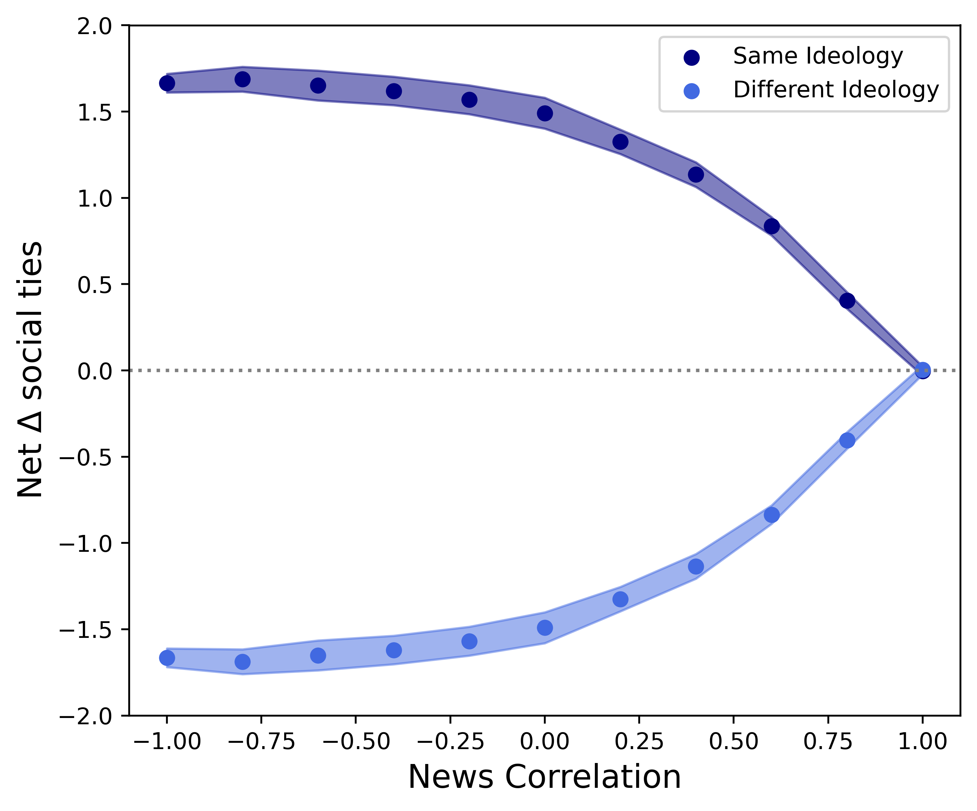
Net Change in Social Ties in a Random Network
Highly correlated news
No change
Less correlated news
Gain social ties with same ideology
Lose social ties with opposing ideology
31-1-2025, Complex System Simulations, group 4

Slide 48
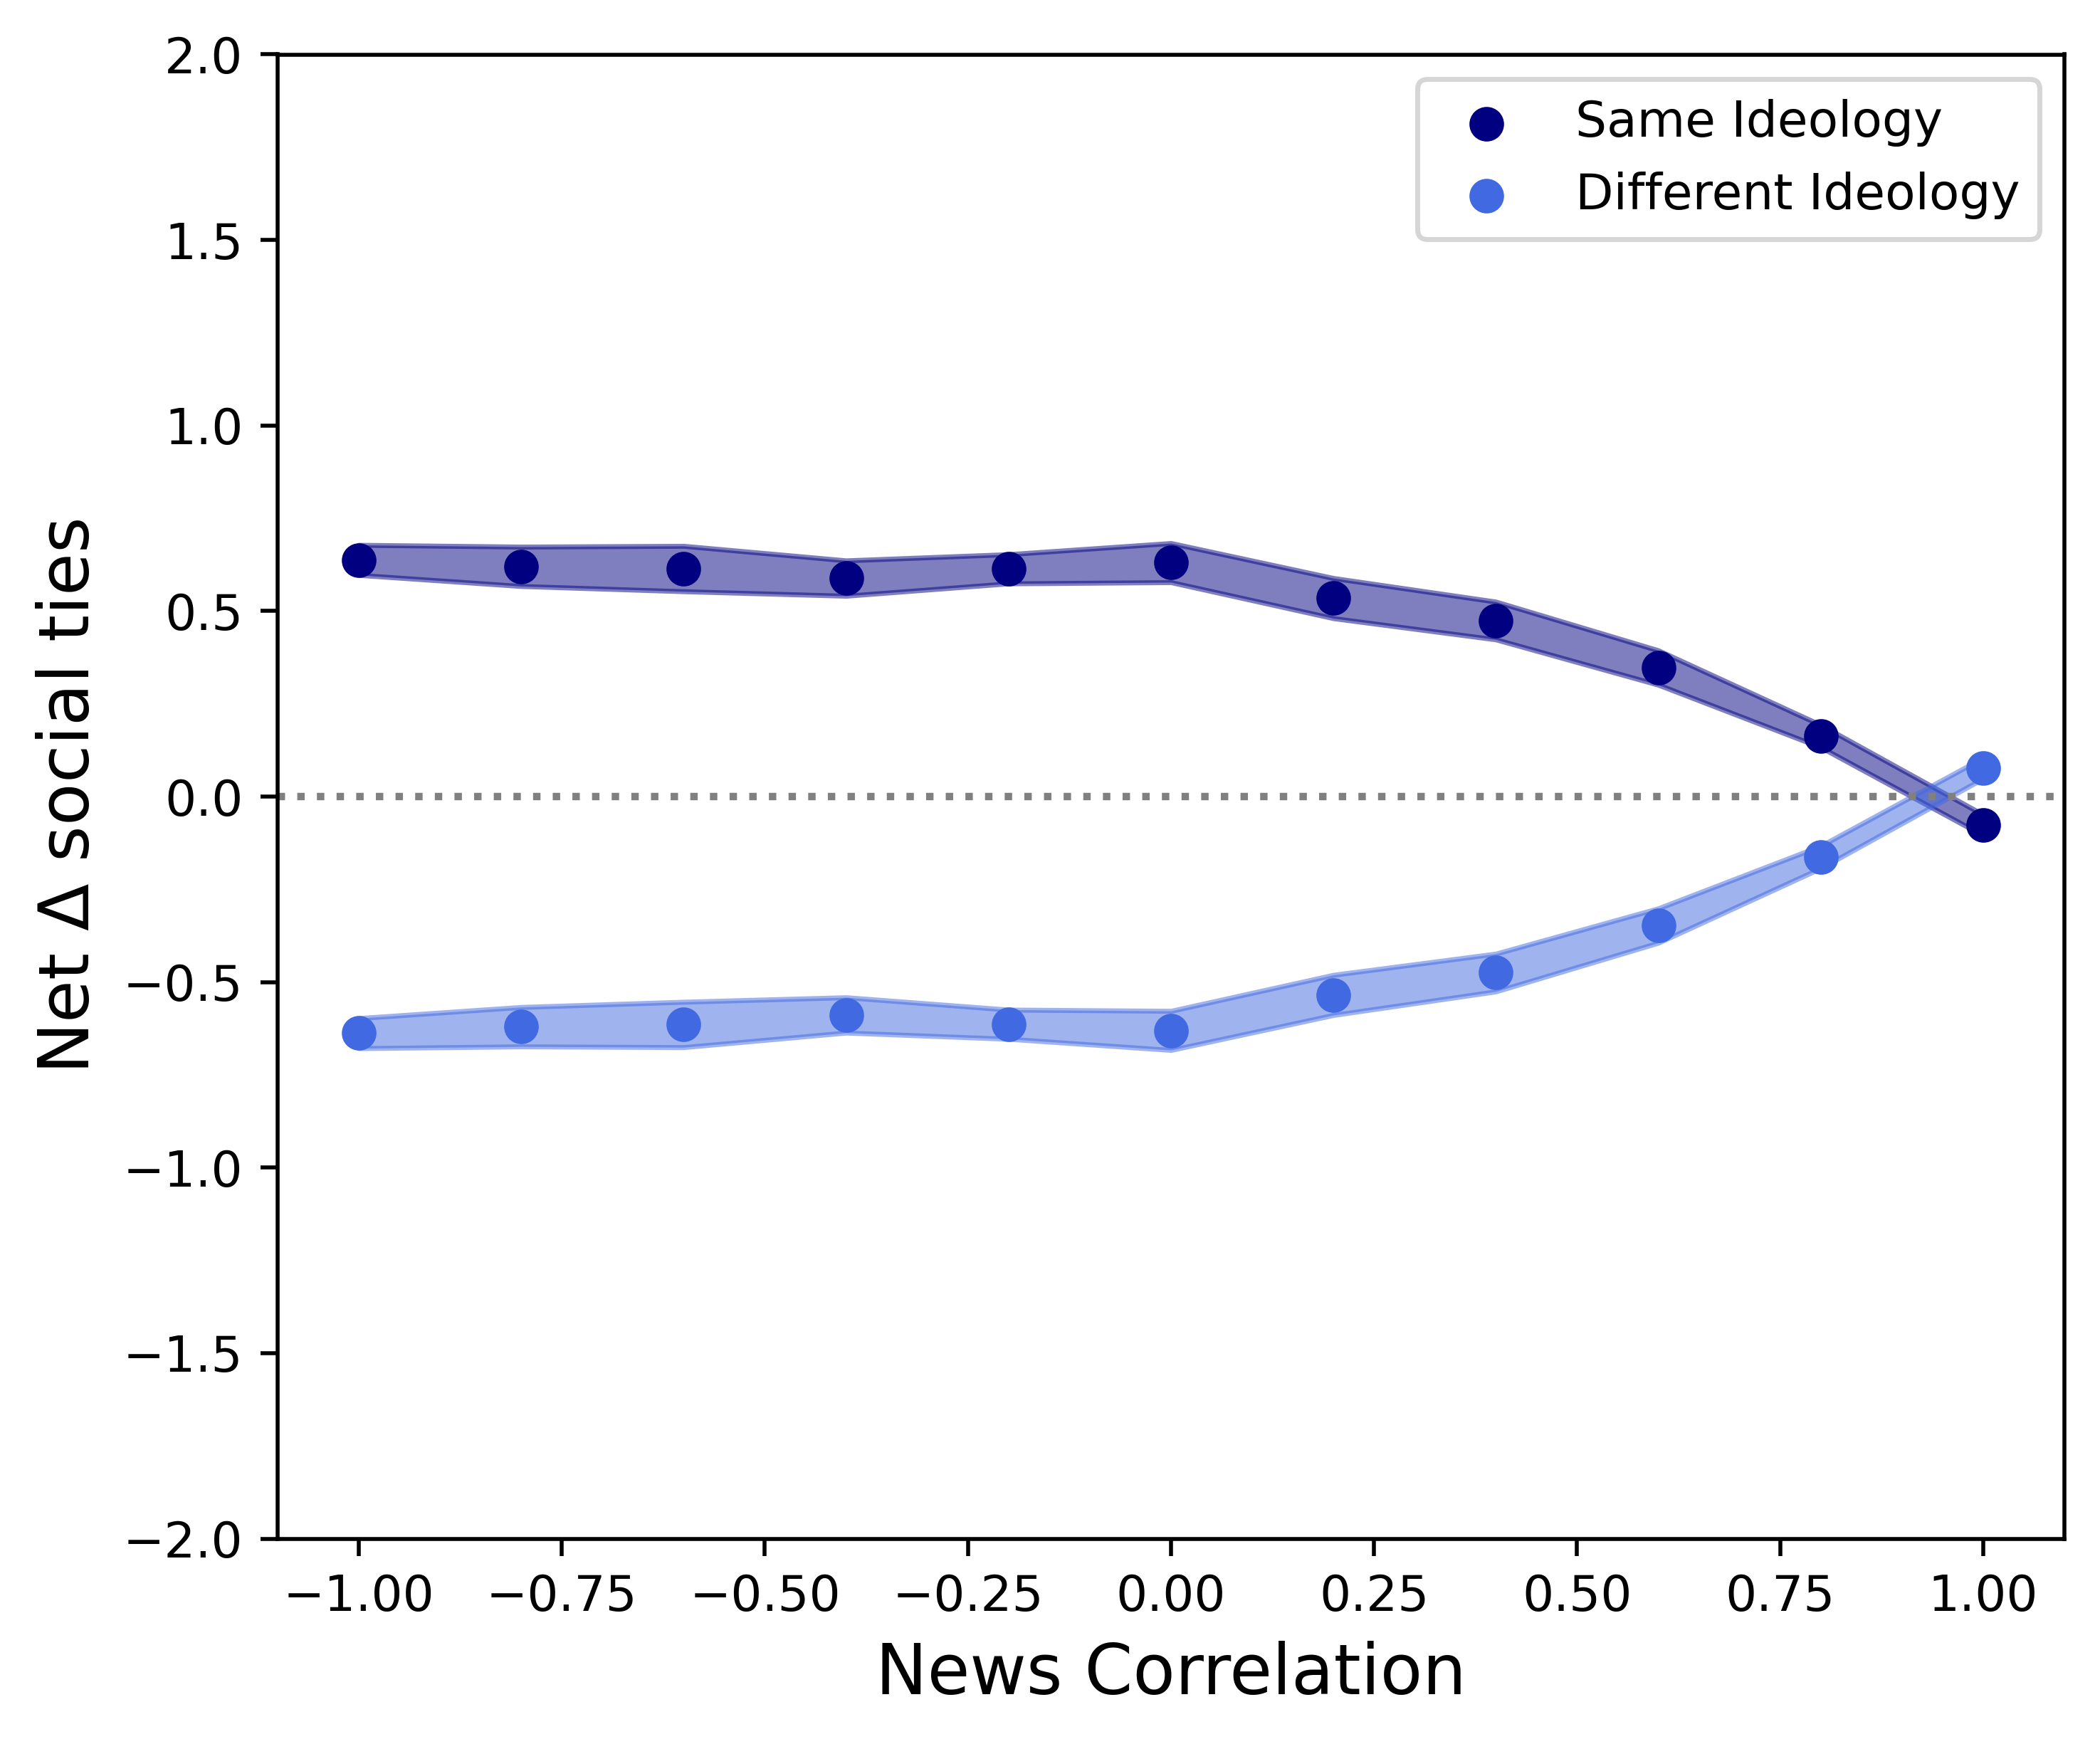
Random vs. Scale-free
31-1-2025, Complex System Simulations, group 4

Slide 49
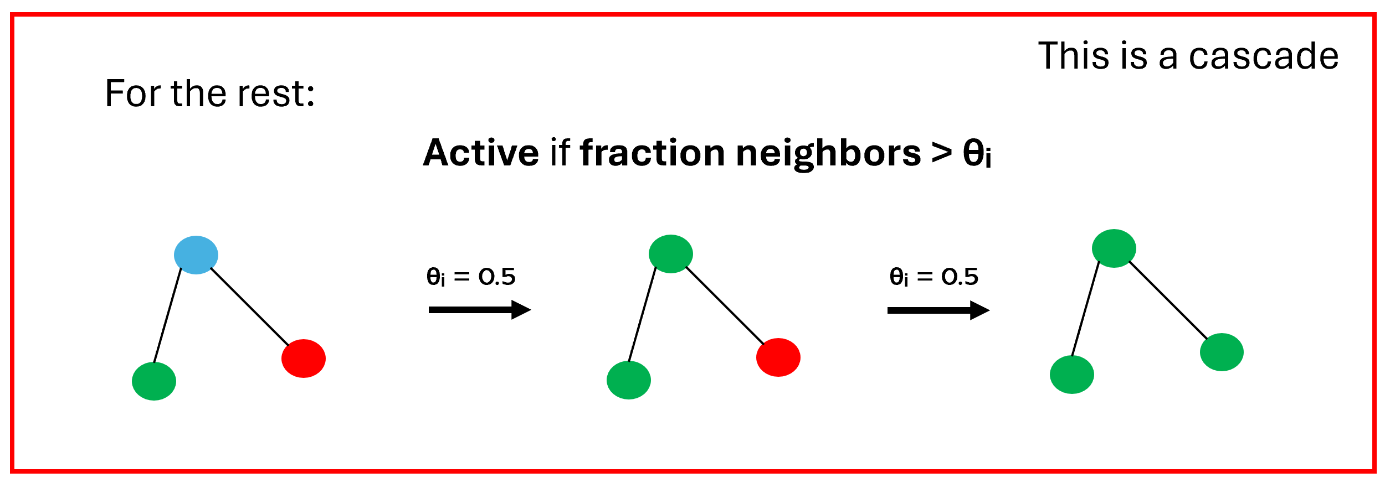
Cascade distributions
Cascades: keeping network structure fixed while distributing news
Metrics
Cascade Sizes
Cascade Polarization: The extend upon which individuals in a cascade have the same political orientation
31-1-2025, Complex System Simulations, group 4

Slide 50
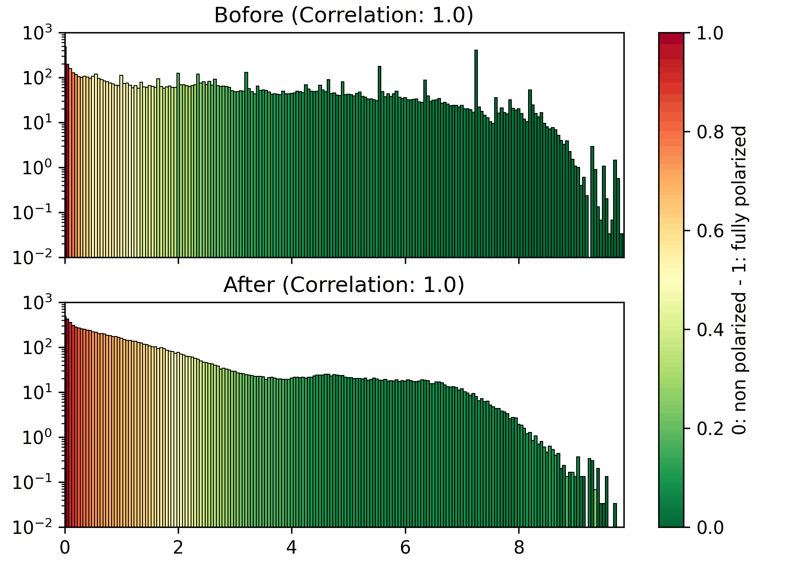
Random: Before Vs After

Slide 51
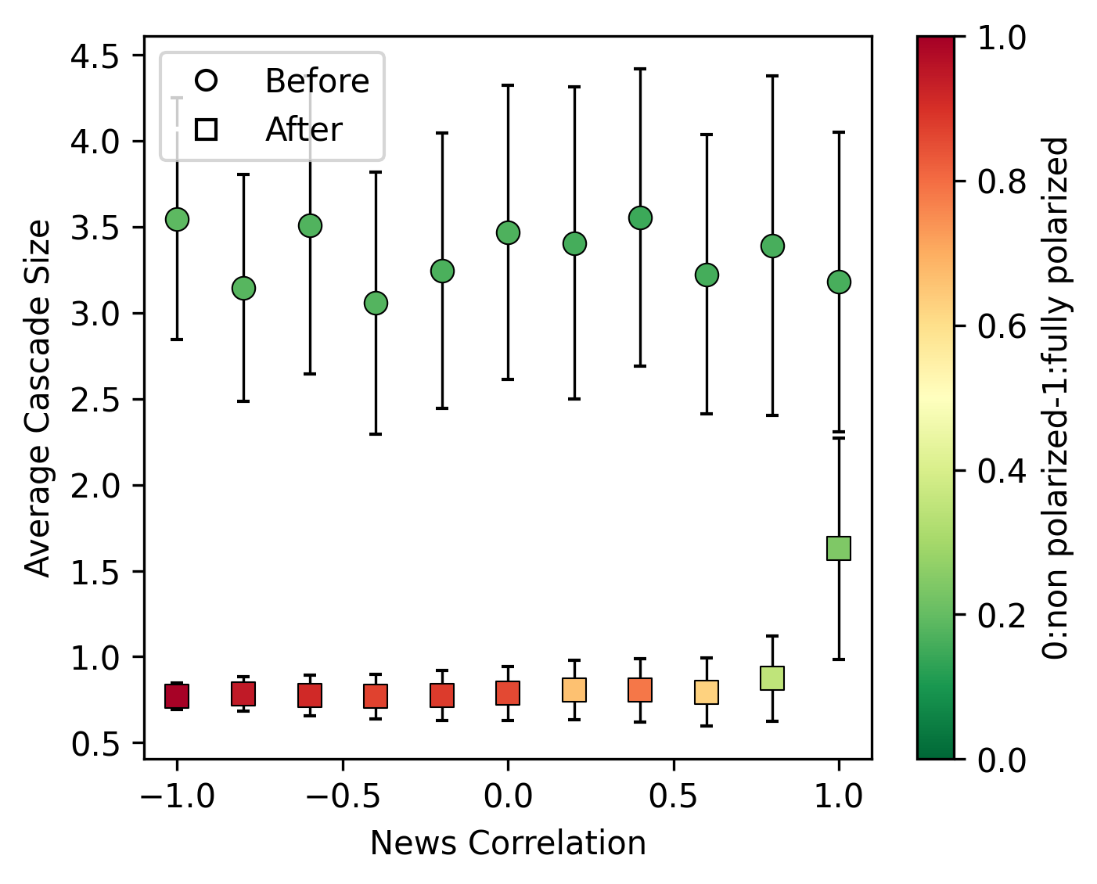
31-1-2025, Complex System Simulations, group 4

Slide 52
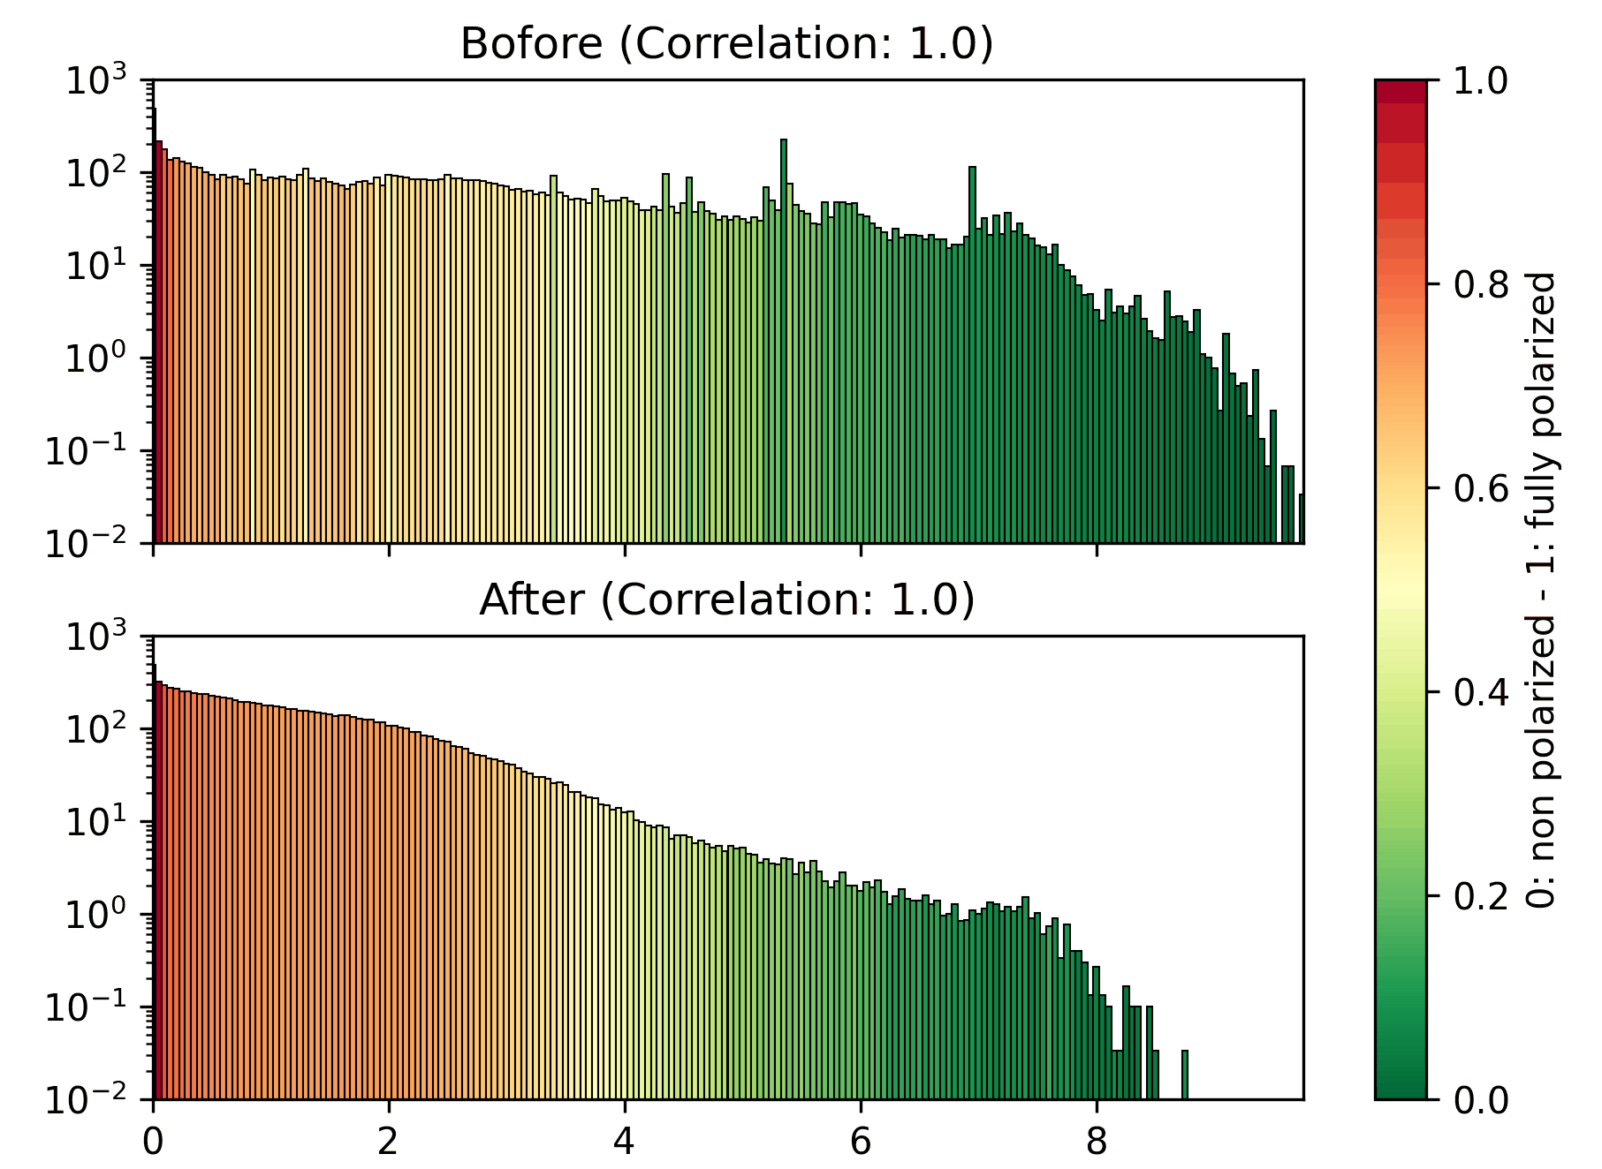
Scale-Free: Before Vs After

Slide 53
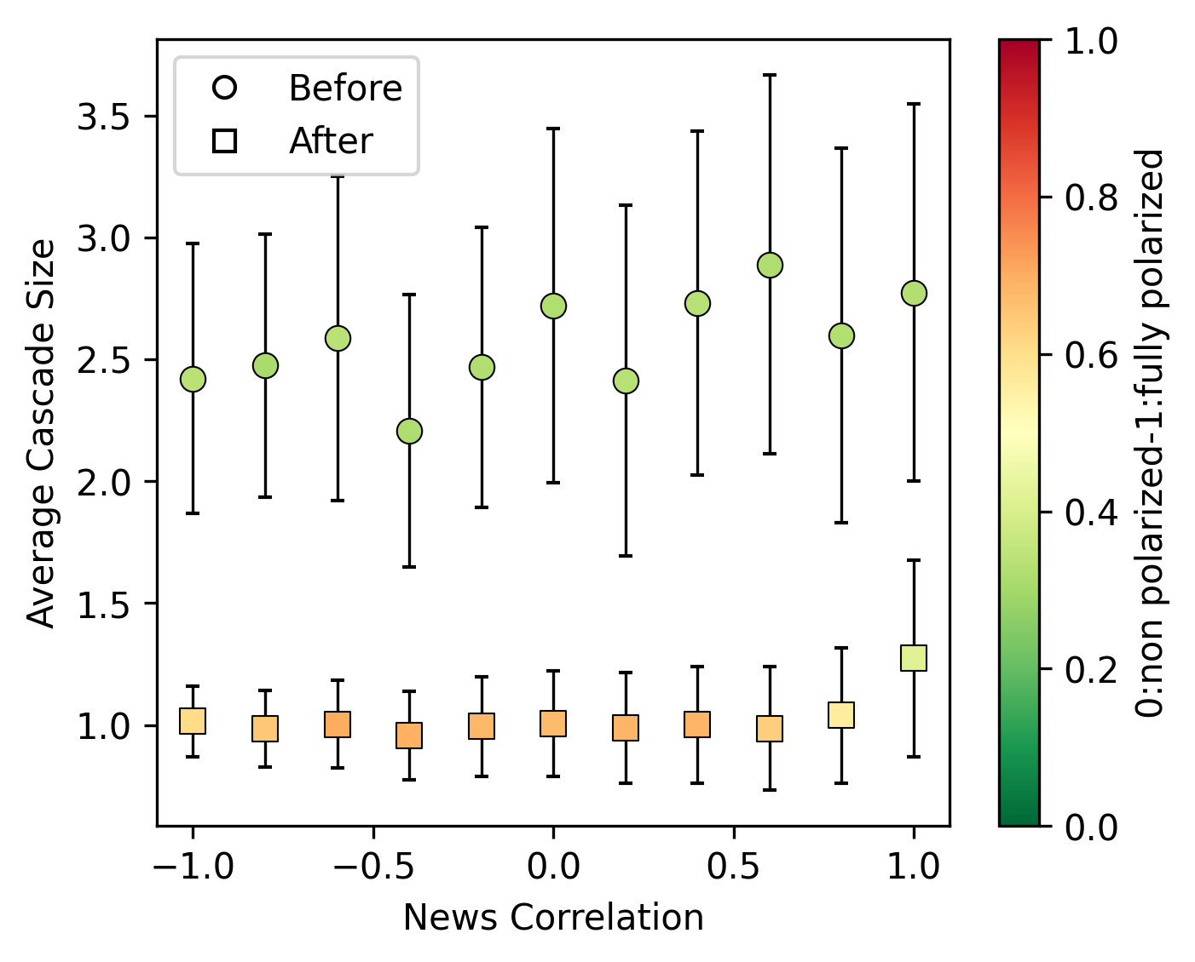
31-1-2025, Complex System Simulations, group 4

Slide 54
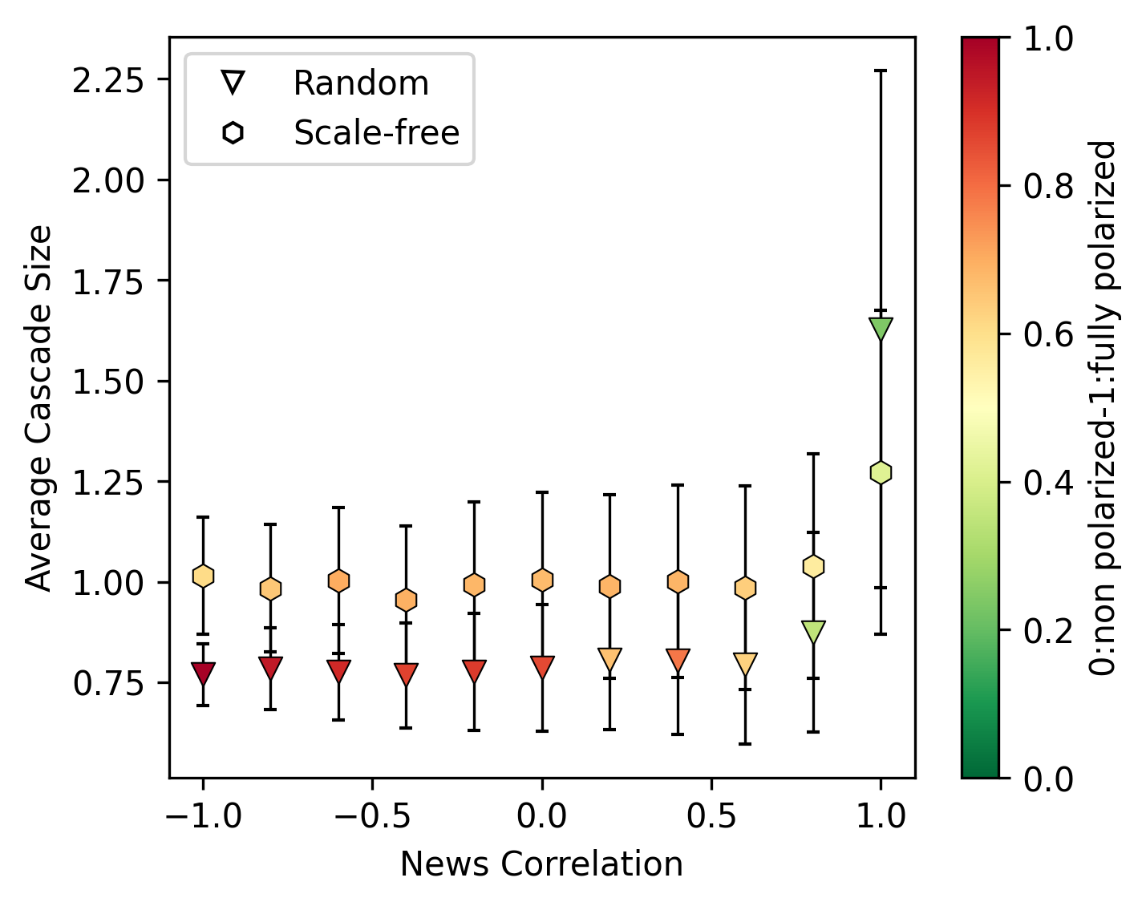
Comparing Scale-Free and Random
31-1-2025, Complex System Simulations, group 4

Slide 55
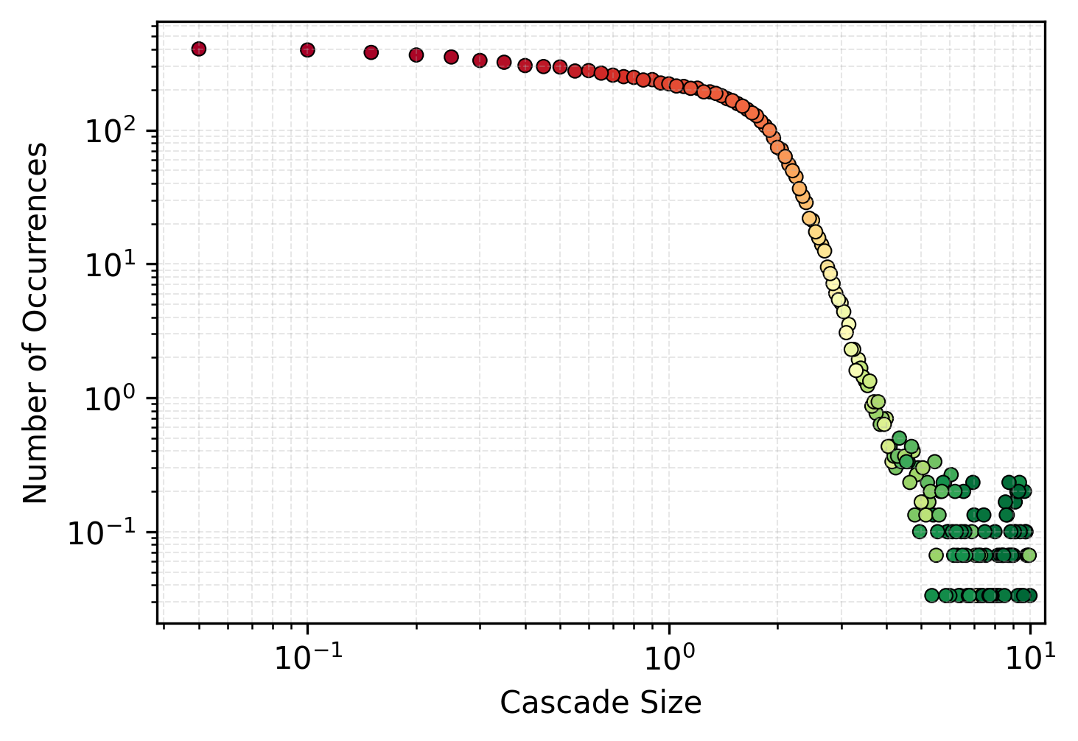
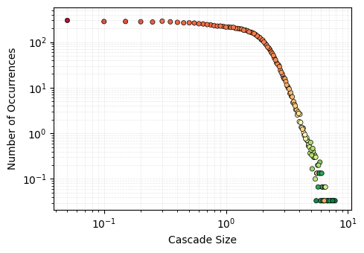
Threshold value for news correlation (0.8)
Cascade Distribution Random
Cascade Distribution Scale-Free
31-1-2025, Complex System Simulations, group 4

Slide 56
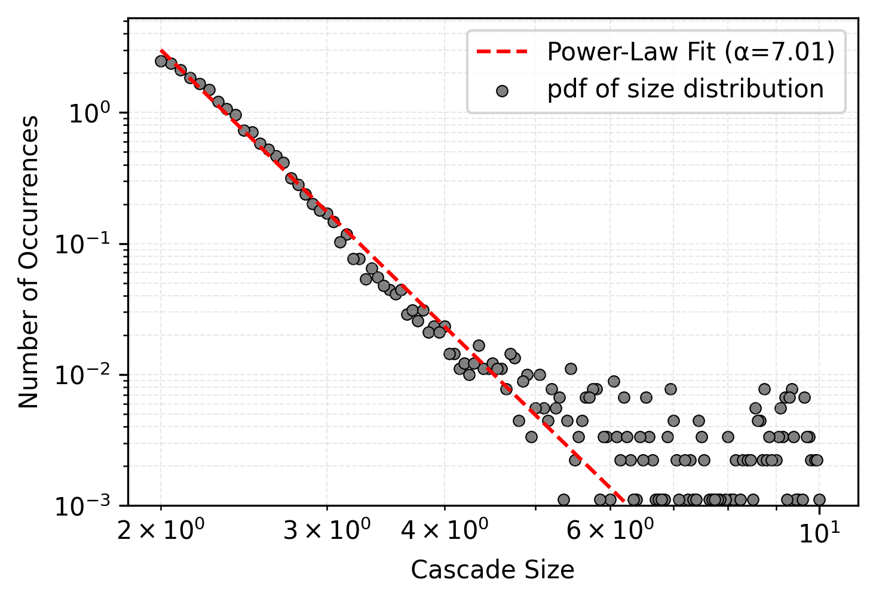
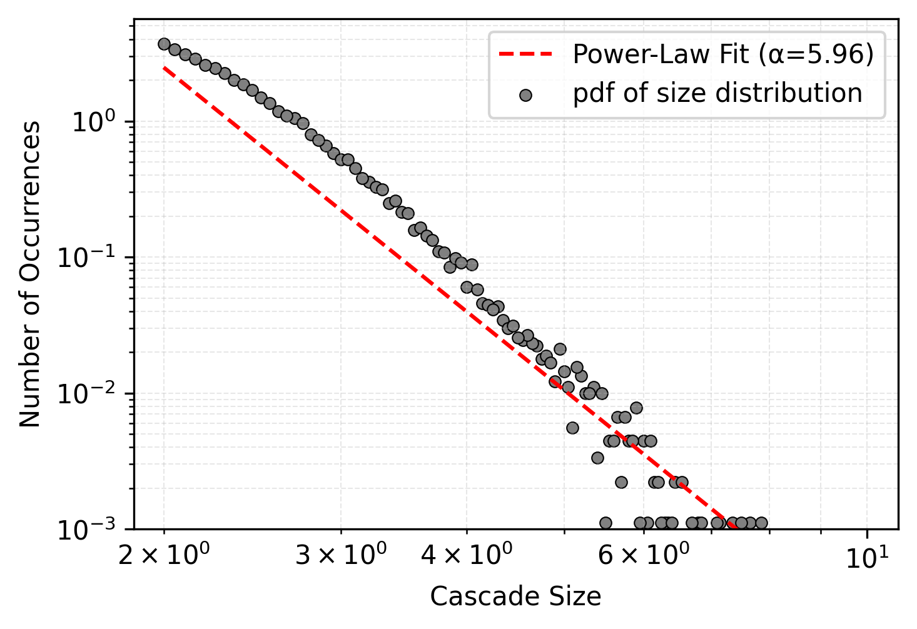
Random Scale-Free
31-1-2025, Complex System Simulations, group 4

Slide 57
Discussion
Power-law: large exponent
Scale-Free:
Less pronounced effect: More iterations
Sensitive to initial conditions
Future work:
Dynamically varying now fixed variables
Implementing rebellious sub-groups
31-1-2025, Complex System Simulations, group 4

Slide 58
Conclusion
Research Question:
How does news correlation influence the polarization of a network without individuals knowing each others political views?
Does this work for a scale-free network?
Answer:
Our algorithm can lead to polarization
This algorithm also polarizes scale-free networks
Estimated a threshold for News Correlation: γ ≈ 0.8
31-1-2025, Complex System Simulations, group 4

Slide 59
A small difference in how news is reported leads to the emergence of a polarized society
31-1-2025, Complex System Simulations, group 4

